Slide 1

Deep Learning
DSBA 6190-U91 | Colby T. Ford, Ph.D.

Slide 2
Overview
Other Cluster Technologies
Intro to Deep Learning
Deep Learning Frameworks
Overview of Neural Networks
Processors

Slide 3
Goals:
Understand what neural networks are.
Understand why you need to use GPUs to train them.
Understand why the cloud might be a good place to do so.

Slide 4
Other Cluster Technologies
Parallel Virtual Machine (PVM)
Only for low-level languages like FORTRAN, C, and C++
Oak Ridge National Laboratory, 1989
Message Passing Interface (MPI)
Only for low-level languages, but plenty of interfaces to higher-level languages like R, Python, Java, etc.
Most popular today.
Dongarra, et al., 1992
Scalable Network of Workstations (SNOW)
Only for R
Tierney, et al., 2009
Common themes:
Multiple machines connected together (ethernet, infiniband, etc.)
Parallelism is based on cores across the cluster
Sharing resources like memory, HDD, CPUs, GPUs, etc.

Slide 5
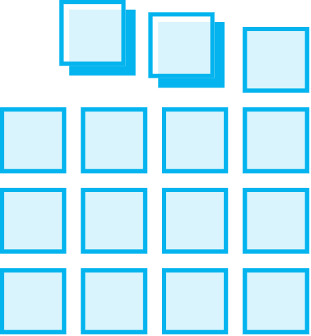
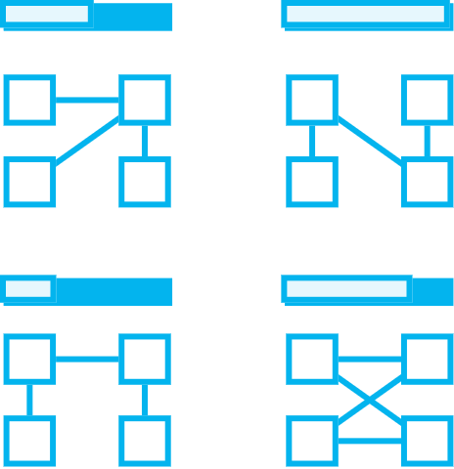


Intro to Machine Learning
Deep
Prepare Data
Build & Train
Deploy
Connect to various sources to ingest data
Train with the data to establish a model
Deploy the model and track performance

Slide 6
Deep Learning Frameworks
TensorFlow
CNTK
MXNet
Microsoft
Google
Apache
PyTorch
Chainer
Facebook
Caffe2
Berkeley
Keras
François Chollet
Preferred Networks
Theano
University of Montreal

Slide 7
Deep Learning Options in the Cloud
Databricks
Machine Learning Services
DLVM

Slide 8
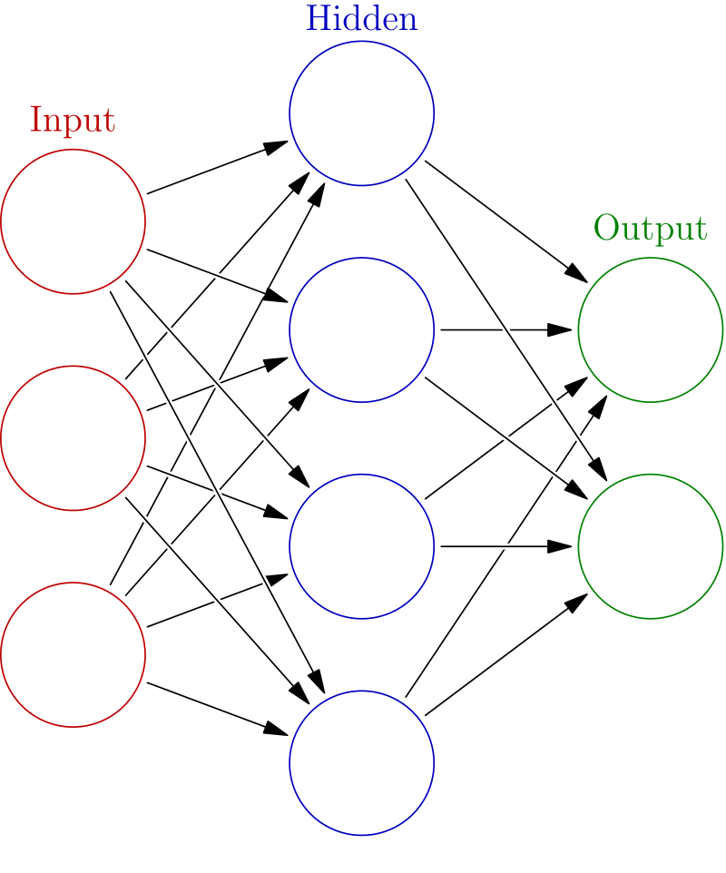
Overview of Neural Networks
Built using interconnected nodes in multiple layers
Layers:
Input:
The set of input features
Hidden:
Set of mathematical functions to compute activations
Output:
The predicted class or value
Connections:
Directional weights
Examples:
Recurrent Neural Networks
Useful for NLP
Convolutional Neural Networks
Useful in Image Recognition
Long Short-Term Memory
Useful for Time Series
…tons more
“Deep” just means there are multiple layers…
https://commons.wikimedia.org/w/index.php?title=File:Colored_neural_network.svg&oldid=279111871
16:07

Slide 9
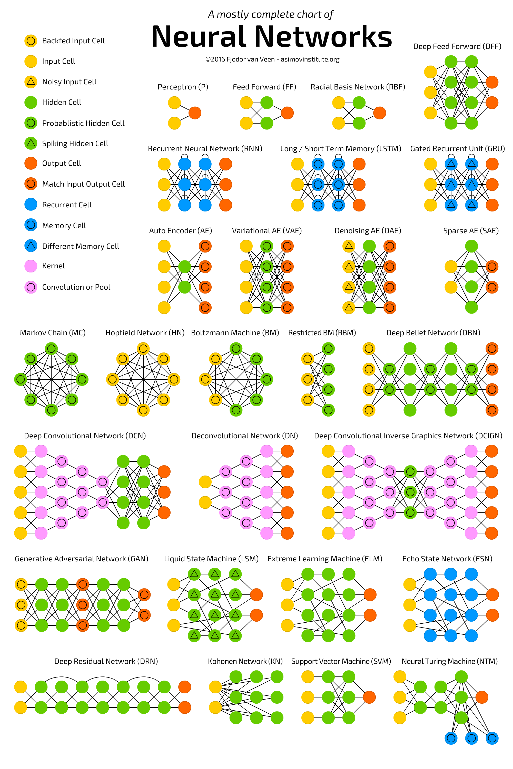
http://www.asimovinstitute.org/neural-network-zoo/

Slide 10

ONNX
Open Neural Network Exchange
An open-source, standardized format for describing neural network models [*.onnx]
Helps in usability when the model object is framework-agnostic
Model Zoo: a place to publish your trained model for open, external use

Slide 11
Types of Processors (Well, the ones relevant to ML/DL/AI)
Central Processing Unit
1-32 Cores
up to ~5GHz
Single precision (32-bit), Double precision (64-bit) and possibly Extended precision (128-bit)
Graphics Processing Unit
100s-1000s of slower cores
~500-1200MHz
Field Programmable Gate Array
Reconfigurable chips to do a specific task – using programmable logic blocks
Tensor Processing Unit
Developed by Google (especially for use in TensorFlow).
High volume, low precision (8-bit)
Proprietary, but can be used on GCP
Useful in IoT/Edge scenarios
Single precision to Double precision

Slide 12


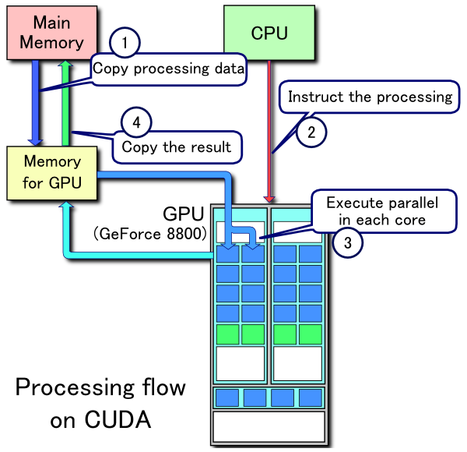
CUDA and OpenCL
CUDA
Developed by Nvidia
For use on Nvidia or CUDA-enable GPUs
Parallelized functionality for linear algebra, sparse matrices, Fourier transforms, random numbers, solvers, graph processing, and more.
OpenCL
Originally developed by Apple, maintained by the Khronos Group
For use in CPUs, GPUs, and FPGAs (for a variety of vendors)
Parallelized functionality for matrix algebra, vectors (especially images)
CUDA Processing Flow by Tosaka [CC BY 3.0 (https://creativecommons.org/licenses/by/3.0)]

Slide 13
Keras Model Walkthrough
IMDB Dataset
Models and Compiling
Layers
Fit, Save, and Show

Slide 14
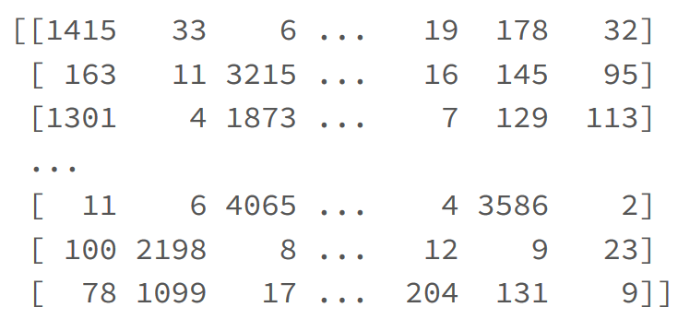
IMDB Dataset
Dataset of 25,000 movies reviews from IMDB, labeled by sentiment (positive/negative). Reviews have been preprocessed, and each review is encoded as a sequence of word indexes (integers).
For convenience, words are indexed by overall frequency in the dataset, so that for instance the integer "3" encodes the 3rd most frequent word in the data. This allows for quick filtering operations such as: "only consider the top 10,000 most common words, but eliminate the top 20 most common words".

Slide 15
Models and Compiling
Sequential – a linear stack of layers. Specify input shape and then add layers
model = Sequential()
model.add(Dense(32, input_shape=(16,)))
model.add(Conv2D(64, (3,3), activation…)
Compiling – set up the performance settings of the model.
Optimizer:
Stochastic gradient descent, RMSprop
Adagrad, Adadelta, Adamax
Adam, Nadam
Loss Function:
Mean squared error, mean absolute error, mean absolute percentage error, mean squared logarithmic error
Hinge, squared hinge
Kullback-Leibler divergence
Logcosh, cosine proximity
Cross entropy
Other Metrics:
Accuracy
model.compile()

Slide 16
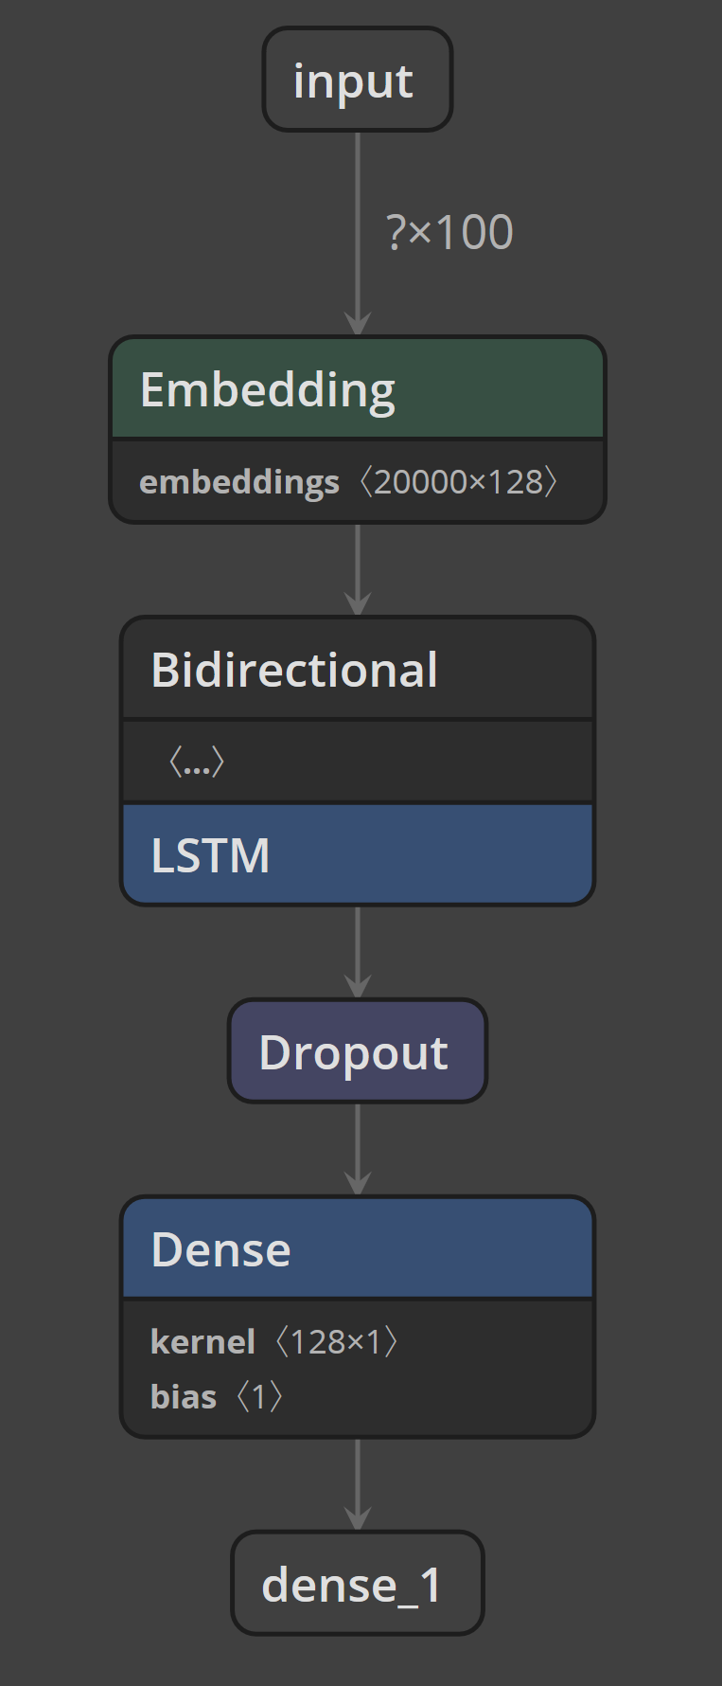
Layers
model.add(Embedding(max_features, 128, input_length=maxlen))
Turns positive integers (indexes) into dense vectors of fixed size.
model.add(Bidirectional(LSTM(64)))
Bidirectional means that the process can move forward and backward.
LSTM creates a ‘long short-term memory’ RNN of a specified size.
model.add(Dropout(0.5))
Dropout consists in randomly setting a fraction (rate) of input units to 0 at each update during training time, which helps prevent overfitting.
model.add(Dense(1, activation='sigmoid'))
The dense layer is fully connected layer, so all the neurons in a layer are connected to those in a next layer.
http://colah.github.io/posts/2015-08-Understanding-LSTMs/

Slide 17
Fit, Save, and Show
CNN Example
Netron
model.fit(x_train, y_train,
batch_size=batch_size,
epochs=4,
validation_data=[x_test, y_test])
Batch size: number of samples per gradient update
Epochs: Number of iterations over the entire x & y data
from keras.models import load_model
# save to the local filesystem
model.save('/tmp/imdb_lstm_model.h5’)
# move to a for future use
dbfs_model_path = 'dbfs:/mnt/general/trainedmodels/dl/imdb_lstm_model.h5’
dbutils.fs.cp('file:/tmp/imdb_lstm_model.h5', dbfs_model_path)

